Slide 1
Tutorial 2
System of linear equations

Slide 2

Naïve Gauss Elimination
Use naïve gauss elimination method to solve the following system of equations:
$2x_{2}+x_{3}=−8$
$x_{1}−2x_{2}−3x_{3}=0$
${−x}_{1}+x_{2}+2x_{3}=3$

Slide 3
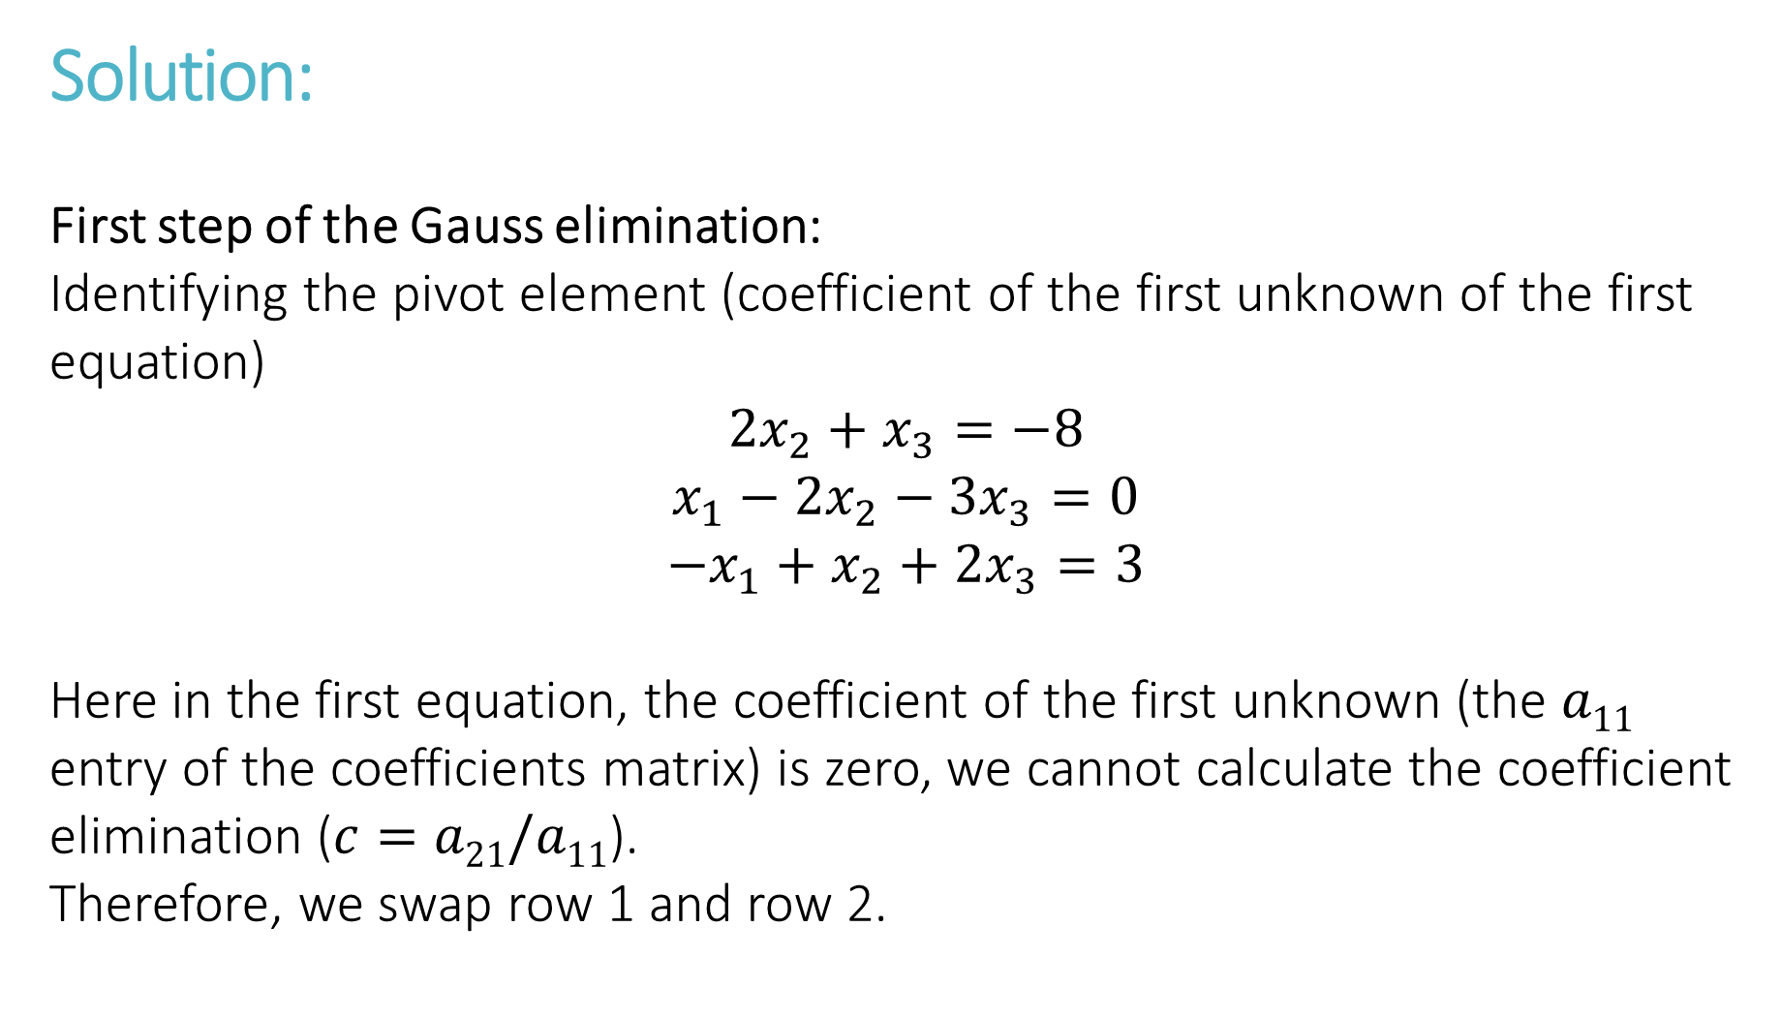
Solution:
First step of the Gauss elimination:
Identifying the pivot element (coefficient of the first unknown of the first equation)
$$2x_{2}+x_{3}=−8$$
$$x_{1}−2x_{2}−3x_{3}=0$$
$${−x}_{1}+x_{2}+2x_{3}=3$$
Here in the first equation, the coefficient of the first unknown (the $a11$ entry of the coefficients matrix) is zero, we cannot calculate the coefficient elimination ($c=a21/a11$).
Therefore, we swap row 1 and row 2.

Slide 4

Solution:
Step 1:
Swap $R1$ and $R2$
$$x_{1}−2x_{2}−3x_{3}=0$$
$2x_{2}+x_{3}=−8$
$${−x}_{1}+x_{2}+2x_{3}=3$$
$$\left[\begin{matrix}1 & −2 & −3 & | & 0 \\ 0 & 2 & 1 & | & −8 \\ −1 & 1 & 2 & | & 3\end{matrix}\right]$$

Slide 5

Solution:
The coefficient of the first unknown is already zero in the second equation. Therefor we go to the third row.
Step 2: $R_{3}−(−R_{1})→R_{3}$
$$x_{1}−2x_{2}−3x_{3}=0$$
$2x_{2}+x_{3}=−8$
$${−x}_{2}−x_{3}=3$$
$$\left[\begin{matrix}1 & −2 & −3 & | & 0 \\ 0 & 2 & 1 & | & −8 \\ 0 & −1 & −1 & | & 3\end{matrix}\right]$$

Slide 6

Solution:
Step 3: $R_{3}−(−\frac{1}{2}R_{2})→R_{3}$
$$x_{1}−2x_{2}−3x_{3}=0$$
$2x_{2}+x_{3}=−8$
$$−0.5x_{3}=−1$$
$$\left[\begin{matrix}1 & −2 & −3 & | & 0 \\ 0 & 2 & 1 & | & −8 \\ 0 & 0 & −0.5 & | & −1\end{matrix}\right]$$
Step 4: Back substitution
$$x_{3}=2$$
$$2x_{2}+2=−8→x_{2}=−5$$
$$x_{1}+10−6=0→x_{1}=−4$$

Slide 7
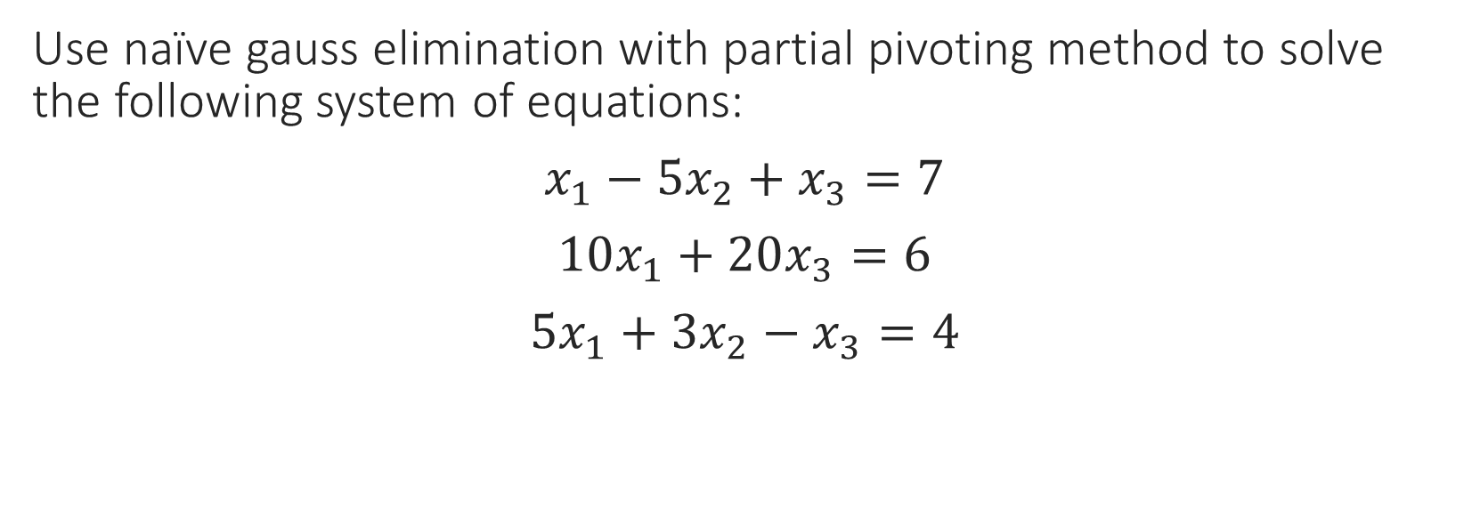
Gauss Elimination with Partial Pivoting
Use naïve gauss elimination with partial pivoting method to solve the following system of equations:
$x_{1}−5x_{2}+x_{3}=7$
$10x_{1}+20x_{3}=6$
${5x}_{1}+3x_{2}−x_{3}=4$

Slide 8

Solution:
Step 1: Scan the first column. 10 is the largest entry and our pivot.
Swap $R1$ and $R2$
$$10x_{1}+20x_{3}=6$$
$$x_{1}−5x_{2}+x_{3}=7$$
$${5x}_{1}+3x_{2}−x_{3}=4$$
$$\left[\begin{matrix}10 & 0 & 20 & | & 6 \\ 1 & −5 & 1 & | & 7 \\ 5 & 3 & −1 & | & 4\end{matrix}\right]$$

Slide 9

Solution:
$$R_{2}−(\frac{1}{10})R_{1}→R_{2}$$
$$\left[\begin{matrix}10 & 0 & 20 & | & 6 \\ 0 & −5 & −1 & | & 6.4 \\ 5 & 3 & −1 & | & 4\end{matrix}\right]$$
$$R_{3}−(\frac{5}{10})R_{1}→R_{3}$$
$$\left[\begin{matrix}10 & 0 & 20 & | & 6 \\ 0 & −5 & −1 & | & 6.4 \\ 0 & 3 & −11 & | & 1\end{matrix}\right]$$

Slide 10

Solution:
Now we scan the second column for the second pivot. -5 is the entry with the highest absolute value.
$$\left[\begin{matrix}10 & 0 & 20 & | & 6 \\ 0 & −5 & −1 & | & 6.4 \\ 0 & 3 & −11 & | & 1\end{matrix}\right]$$
$$R_{3}−(\frac{3}{−5})R_{2}→R_{3}$$
$$\left[\begin{matrix}10 & 0 & 20 & | & 6 \\ 0 & −5 & −1 & | & 6.4 \\ 0 & 0 & −1.16 & | & 4.84\end{matrix}\right]→ x_{1}= \frac{208}{145} , x_{2}= \frac{−347}{290} , x_{3}=\frac{−121}{290}$$

Slide 11
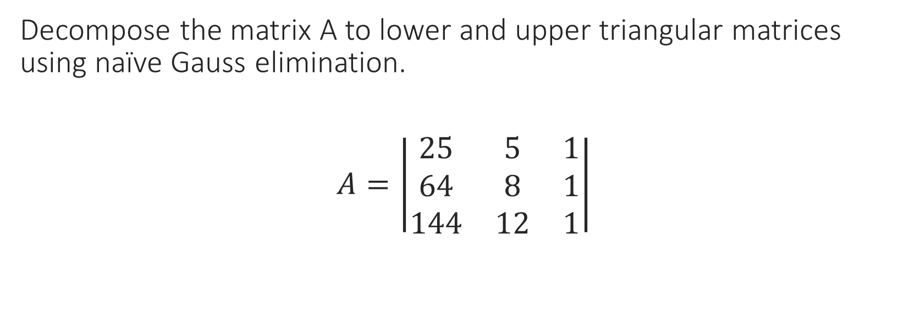
LU Decomposition
Decompose the matrix A to lower and upper triangular matrices using naïve Gauss elimination.
$A=\left|\begin{matrix}25 & 5 & 1 \\ 64 & 8 & 1 \\ 144 & 12 & 1\end{matrix}\right|$

Slide 12

Solution:
Gauss elimination starts with 25(pivot)
$R_{2}−(\frac{a_{21}}{a_{11}})R_{1}→R_{2}$ $l_{21}=\frac{a_{21}}{a_{11}}$
$$U=\left|\begin{matrix}25 & 5 & 1 \\ 0 & \frac{−24}{5} & \frac{−39}{25} \\ 144 & 12 & 1\end{matrix}\right| L=\left|\begin{matrix}1 & 0 & 0 \\ \frac{64}{25} & 1 & 0 \\ l_{31} & l_{32} & 1\end{matrix}\right|$$

Slide 13

Solution:
$R_{3}−(\frac{a_{31}}{a_{11}})R_{1}→R_{3}$ $l_{31}=\frac{a_{31}}{a_{11}}$
$$U=\left|\begin{matrix}25 & 5 & 1 \\ 0 & \frac{−24}{5} & \frac{−39}{25} \\ 0 & \frac{−84}{5} & \frac{−119}{25}\end{matrix}\right| L=\left|\begin{matrix}1 & 0 & 0 \\ \frac{64}{25} & 1 & 0 \\ \frac{144}{25} & l_{32} & 1\end{matrix}\right|$$
$R_{3}−(\frac{a_{32}}{a_{22}})R_{2}→R_{3}$ $l_{32}=\frac{a_{32}}{a_{22}}$
$$U=\left|\begin{matrix}25 & 5 & 1 \\ 0 & \frac{−24}{5} & \frac{−39}{25} \\ 0 & 0 & 0.7\end{matrix}\right| L=\left|\begin{matrix}1 & 0 & 0 \\ \frac{64}{25} & 1 & 0 \\ \frac{144}{25} & 3.5 & 1\end{matrix}\right|$$

Slide 14
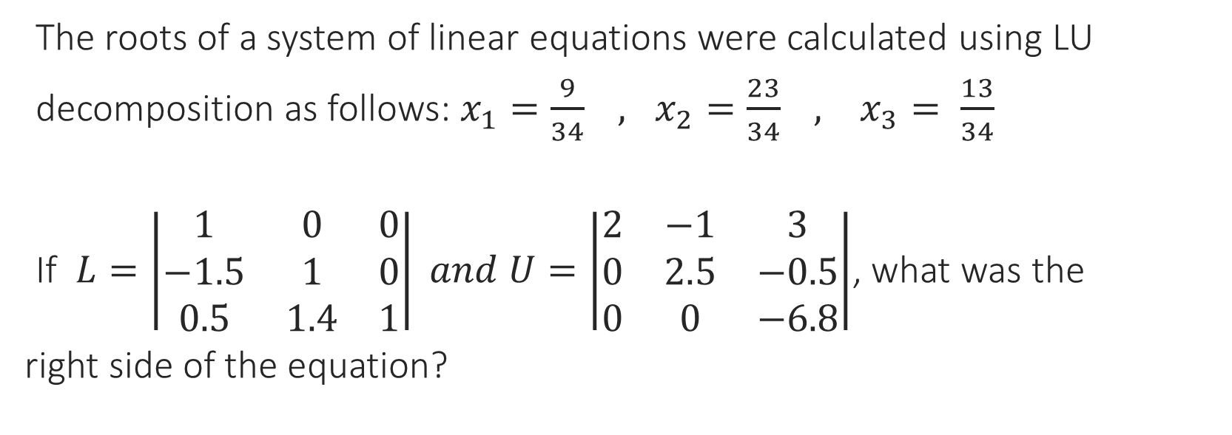
Solving a System of Linear Equations by LU Decomposition
The roots of a system of linear equations were calculated using LU
decomposition as follows: $x_{1}=\frac{9}{34} , x_{2}=\frac{23}{34} , x_{3}= \frac{13}{34}$
If $L=\left|\begin{matrix}1 & 0 & 0 \\ −1.5 & 1 & 0 \\ 0.5 & 1.4 & 1\end{matrix}\right| and U=\left|\begin{matrix}2 & −1 & 3 \\ 0 & 2.5 & −0.5 \\ 0 & 0 & −6.8\end{matrix}\right|$, what was the
right side of the equation?

Slide 15
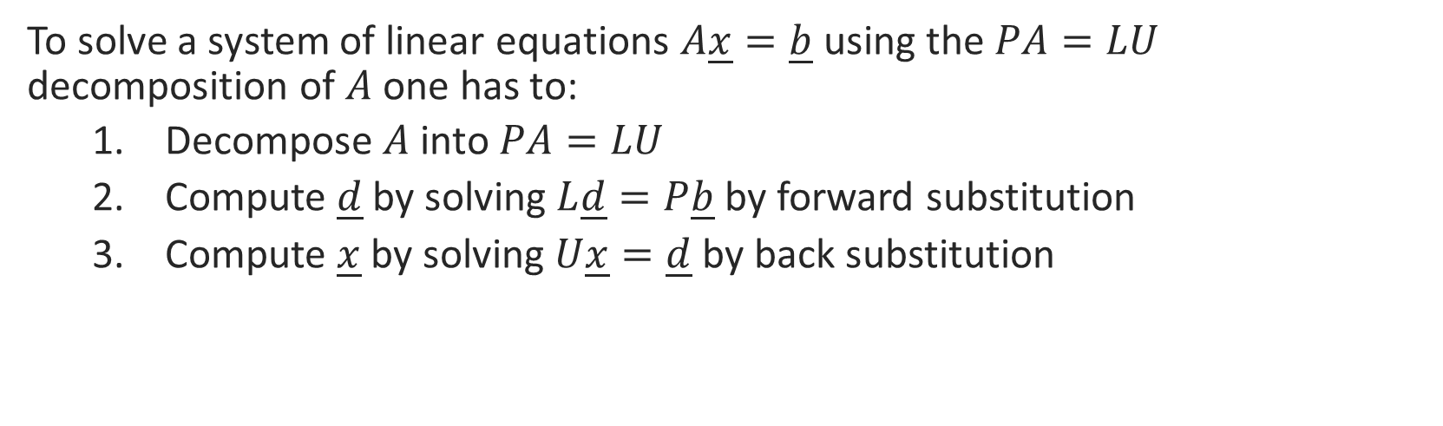
Solving systems of linear equations with the PA=LU decomposition
To solve a system of linear equations $A\underline{x}=\underline{b}$ using the $PA=LU$ decomposition of $A$ one has to:
Decompose $A$ into $PA=LU$
Compute $\underline{d}$ by solving $L\underline{d}=P\underline{b}$ by forward substitution
Compute $\underline{x}$ by solving $U\underline{x}=\underline{d}$ by back substitution
PA x = P b LU x = P b Ld = Pb U x = d

Slide 16
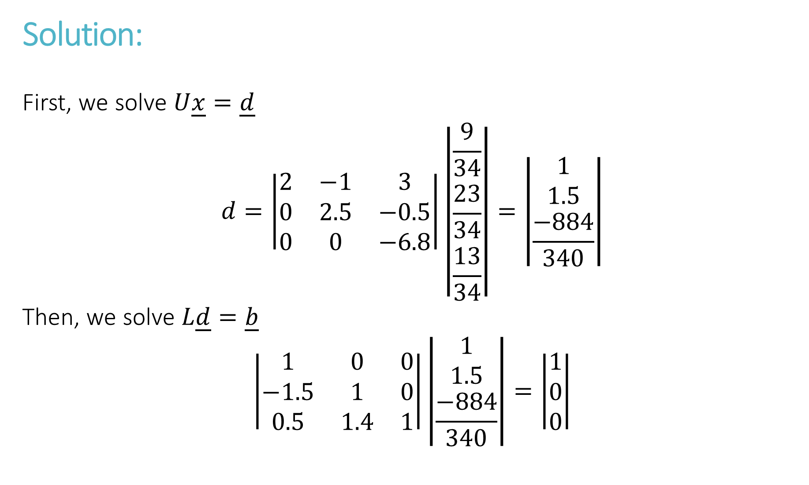
Solution:
First, we solve $U\underline{x}=\underline{d}$
$$d=\left|\begin{matrix}2 & −1 & 3 \\ 0 & 2.5 & −0.5 \\ 0 & 0 & −6.8\end{matrix}\right|\left|\begin{matrix}\frac{9}{34} \\ \frac{23}{34} \\ \frac{13}{34}\end{matrix}\right|=\left|\begin{matrix}1 \\ 1.5 \\ \frac{−884}{340}\end{matrix}\right|$$
Then, we solve $L\underline{d}=\underline{b}$
$$\left|\begin{matrix}1 & 0 & 0 \\ −1.5 & 1 & 0 \\ 0.5 & 1.4 & 1\end{matrix}\right|\left|\begin{matrix}1 \\ 1.5 \\ \frac{−884}{340}\end{matrix}\right|=\left|\begin{matrix}1 \\ 0 \\ 0\end{matrix}\right|$$

Slide 17
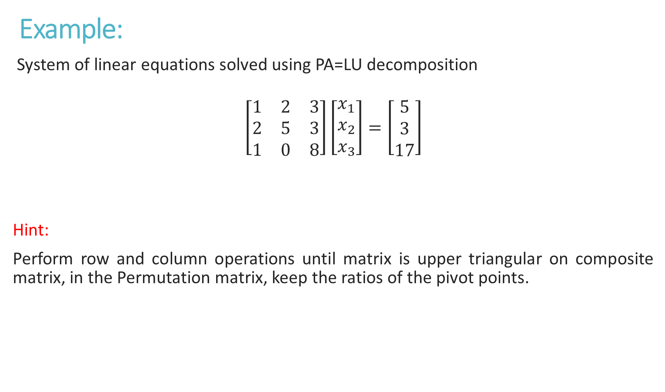
Example:
System of linear equations solved using PA=LU decomposition
$$\left[\begin{matrix}1 & 2 & 3 \\ 2 & 5 & 3 \\ 1 & 0 & 8\end{matrix}\right]\left[\begin{matrix}x_{1} \\ x_{2} \\ x_{3}\end{matrix}\right]=\left[\begin{matrix}5 \\ 3 \\ 17\end{matrix}\right]$$
Hint:
Perform row and column operations until matrix is upper triangular on composite matrix, in the Permutation matrix, keep the ratios of the pivot points.
A
x
b

Slide 18

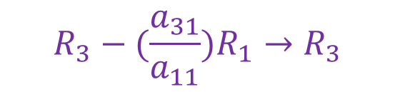


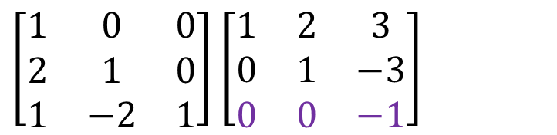
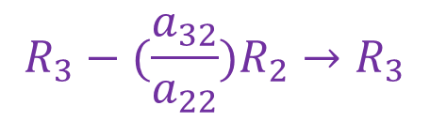
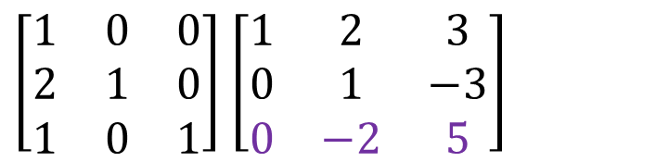

First Step: Decompose $A$ into $PA=LU$
PA= $\left[\begin{matrix}1 & 0 & 0 \\ 0 & 1 & 0 \\ 0 & 0 & 1\end{matrix}\right]$ $\left[\begin{matrix}1 & 2 & 3 \\ 2 & 5 & 3 \\ 1 & 0 & 8\end{matrix}\right]$ $R_{2}−(\frac{a_{21}}{a_{11}})R_{1}→R_{2} \left[\begin{matrix}1 & 0 & 0 \\ 2 & 1 & 0 \\ 0 & 0 & 1\end{matrix}\right]$ $\left[\begin{matrix}1 & 2 & 3 \\ 0 & 1 & −3 \\ 1 & 0 & 8\end{matrix}\right]$
$$l_{21}=\frac{a_{21}}{a_{11}}$$
P
$$R_{3}−(\frac{a_{31}}{a_{11}})R_{1}→R_{3}$$
$\left[\begin{matrix}1 & 0 & 0 \\ 2 & 1 & 0 \\ 1 & −2 & 1\end{matrix}\right]$ $\left[\begin{matrix}1 & 2 & 3 \\ 0 & 1 & −3 \\ 0 & 0 & −1\end{matrix}\right]$
$\left[\begin{matrix}1 & 0 & 0 \\ 2 & 1 & 0 \\ 1 & 0 & 1\end{matrix}\right]$ $\left[\begin{matrix}1 & 2 & 3 \\ 0 & 1 & −3 \\ 0 & −2 & 5\end{matrix}\right]$
$$R_{3}−(\frac{a_{32}}{a_{22}})R_{2}→R_{3}$$
$$l_{32}=\frac{a_{32}}{a_{22}}$$
$$l_{31}=\frac{a_{31}}{a_{11}}$$
L
U

Slide 19
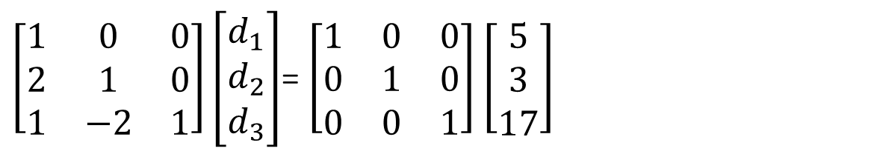


Second Step: Compute $\underline{d}$ By Solving $L\underline{d}=P\underline{b}$ By Forward Substitution
$\left[\begin{matrix}d_{1} \\ d_{2} \\ d_{3}\end{matrix}\right]$= $\left[\begin{matrix}5 \\ −7 \\ −2\end{matrix}\right]$
$\left[\begin{matrix}1 & 0 & 0 \\ 2 & 1 & 0 \\ 1 & −2 & 1\end{matrix}\right]\left[\begin{matrix}d_{1} \\ d_{2} \\ d_{3}\end{matrix}\right]$= $\left[\begin{matrix}1 & 0 & 0 \\ 0 & 1 & 0 \\ 0 & 0 & 1\end{matrix}\right]$ $\left[\begin{matrix}5 \\ 3 \\ 17\end{matrix}\right]$
L
d
P
b

Slide 20



Last Step: Compute $\underline{x}$ By Solving $U\underline{x}=\underline{d}$ By Back Substitution
$\left[\begin{matrix}x_{1} \\ x_{2} \\ x_{3}\end{matrix}\right]$= $\left[\begin{matrix}1 \\ −1 \\ 2\end{matrix}\right]$
$\left[\begin{matrix}1 & 2 & 3 \\ 0 & 1 & −3 \\ 0 & 0 & −1\end{matrix}\right]$ $\left[\begin{matrix}x_{1} \\ x_{2} \\ x_{3}\end{matrix}\right]$=$\left[\begin{matrix}5 \\ −7 \\ −2\end{matrix}\right]$
U
d

Slide 21
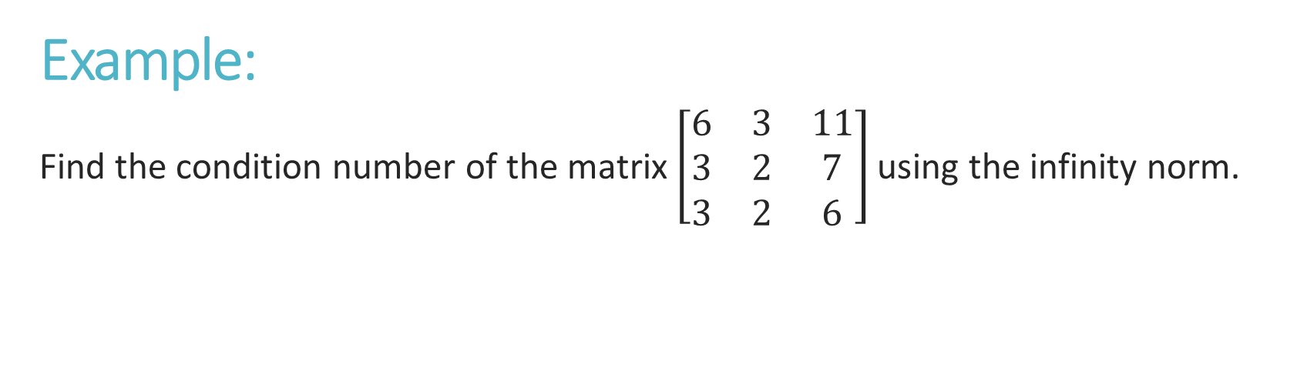
Condition Number Using The Infinity Norm
Example:
Find the condition number of the matrix $\left[\begin{matrix}6 & 3 & 11 \\ 3 & 2 & 7 \\ 3 & 2 & 6\end{matrix}\right]$using the infinity norm.

Slide 22
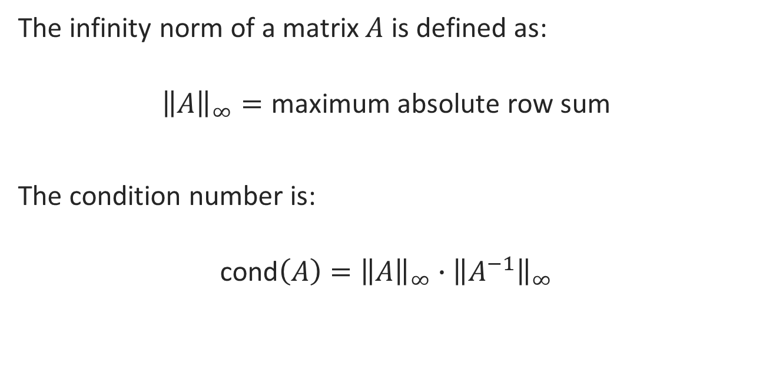
Solution:
The infinity norm of a matrix $A$ is defined as:
$${\left\|A\right\|}_{∞}=\text{maximum} \text{absolute} \text{row} \text{sum}$$
The condition number is:
$$\text{cond}\left(A\right)={\left\|A\right\|}_{∞}∙{\left\|A^{−1}\right\|}_{∞}$$

Slide 23
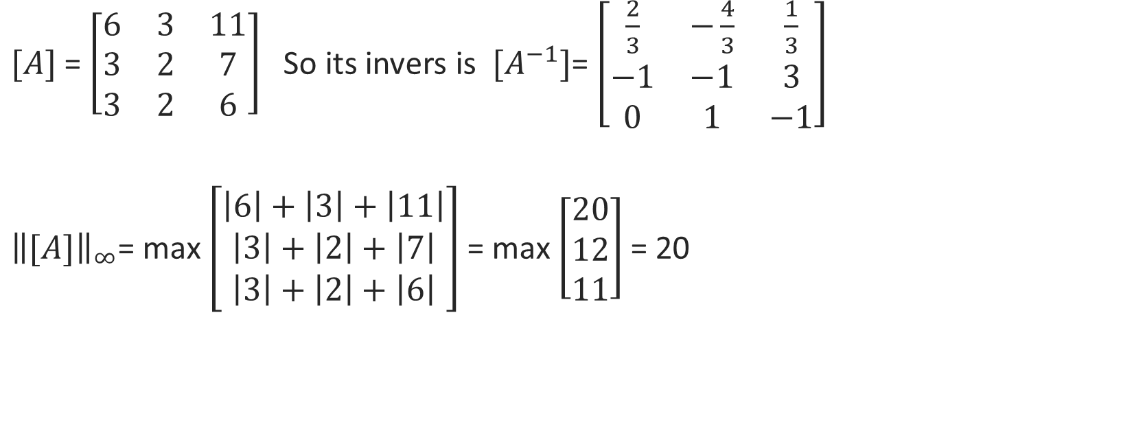
Solution:
$[A]$= $\left[\begin{matrix}6 & 3 & 11 \\ 3 & 2 & 7 \\ 3 & 2 & 6\end{matrix}\right]$So its invers is $[A^{−1}]$= $\left[\begin{matrix}\frac{2}{3} & −\frac{4}{3} & \frac{1}{3} \\ −1 & −1 & 3 \\ 0 & 1 & −1\end{matrix}\right]$
${\left\|[A]\right\|}_{∞}$= max $\left[\begin{aligned}\left|6\right|+\left|3\right|+\left|11\right| \\ \left|3\right|+\left|2\right|+\left|7\right| \\ \left|3\right|+\left|2\right|+\left|6\right|\end{aligned}\right]$ = max $\left[\begin{aligned}20 \\ 12 \\ 11\end{aligned}\right]$ = 20

Slide 24
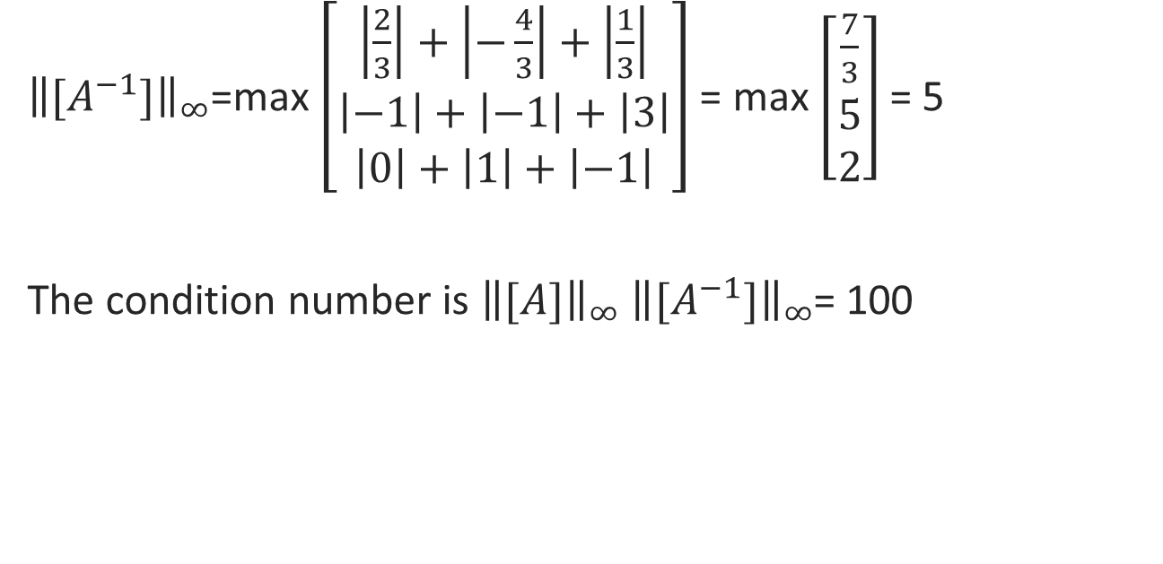
Solution:
${\left\|[A^{−1}]\right\|}_{∞}$=max $\left[\begin{aligned}\left|\frac{2}{3}\right|+\left|−\frac{4}{3}\right|+\left|\frac{1}{3}\right| \\ \left|−1\right|+\left|−1\right|+\left|3\right| \\ \left|0\right|+\left|1\right|+\left|−1\right|\end{aligned}\right]$ = max $\left[\begin{aligned}\frac{7}{3} \\ 5 \\ 2\end{aligned}\right]$ = 5
The condition number is ${\left\|[A]\right\|}_{∞}$ ${\left\|[A^{−1}]\right\|}_{∞}$= 100

